Slide 1
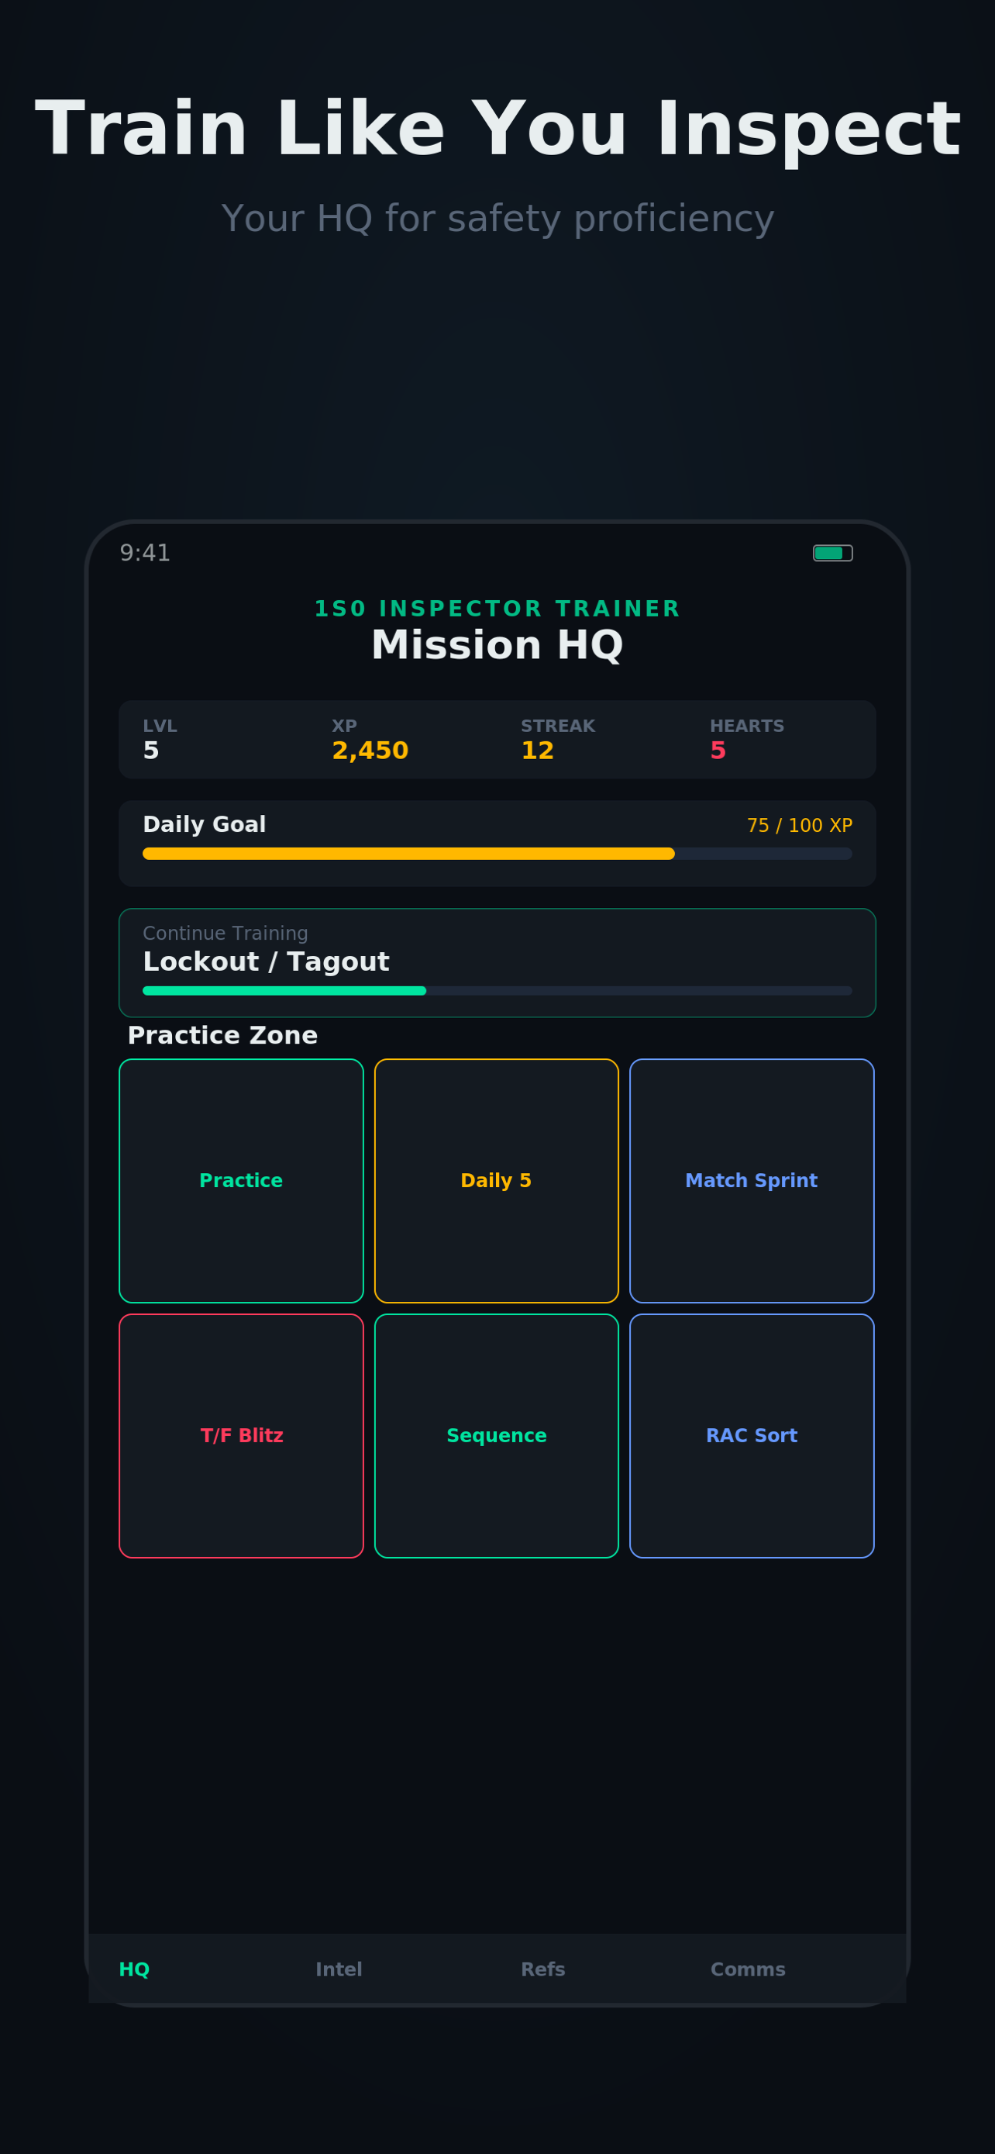

1S0 Inspector Trainer
Scenario-Based Safety Training
for the Modern Inspector
Train like you inspect.

Slide 2



The Problem
Knowledge Decay
No Mobile Option
Passive Learning
Inspectors lose proficiency between real-world inspections with no structured refresher system.
Current training is classroom or CBT-bound. No way to train on-the-go during downtime.
Slide decks and PDFs don't build decision-making skills needed in the field.

Slide 3






The Solution
A native iOS app purpose-built for 1S0 safety professionals
14 Interactive Modules
Scenario-Driven Training
LOTO, Fall Protection, RM, Confined Space, Hot Work, and 9 more
Decision paths with instant feedback and timed pressure mode
Quizzes & Assessments
XP & Gamification
Randomized quick-checks with pass/fail scoring and summaries
Levels, streaks, daily goals, hearts, and badges
Zero Data Collection
Native iOS App
No accounts, no ads, no analytics. All data stays on-device
SwiftUI-built, fast, designed for phone-in-hand use

Slide 4
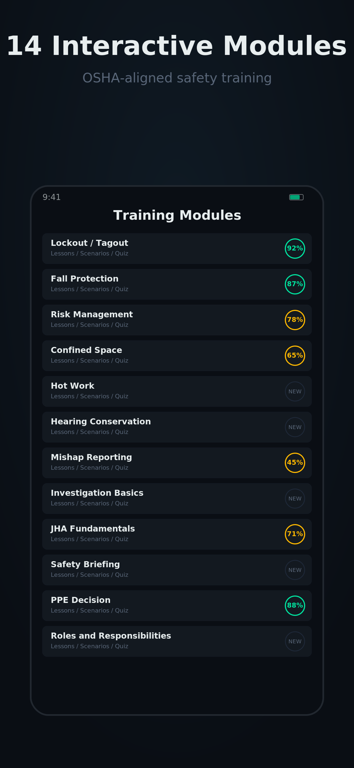
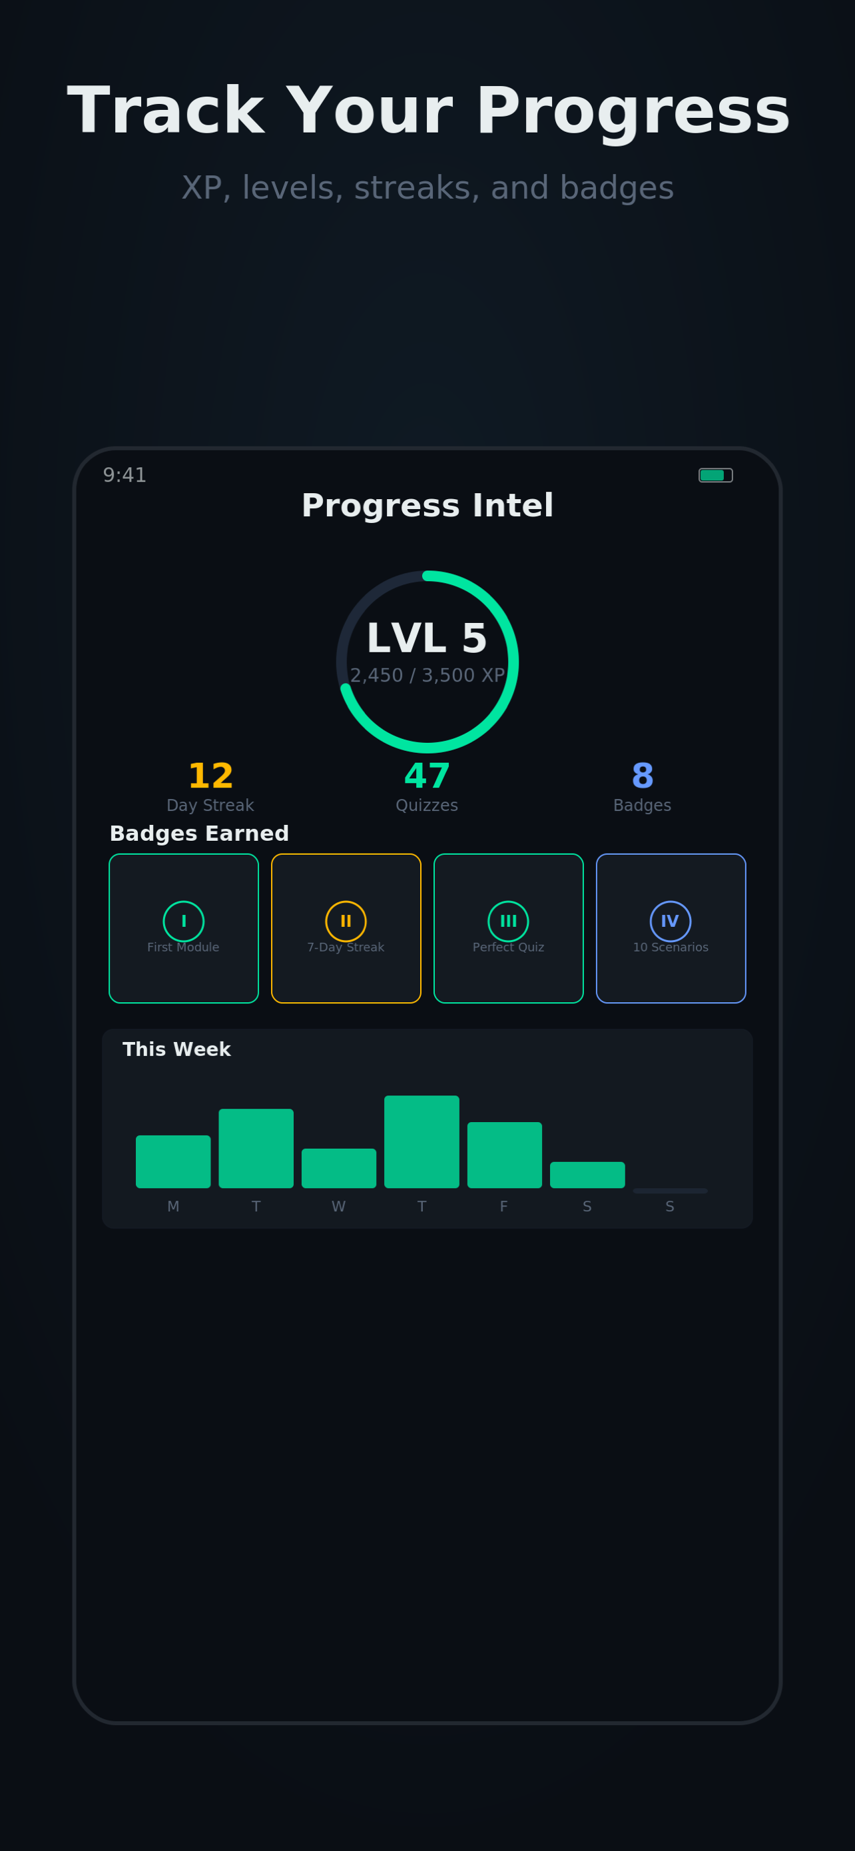
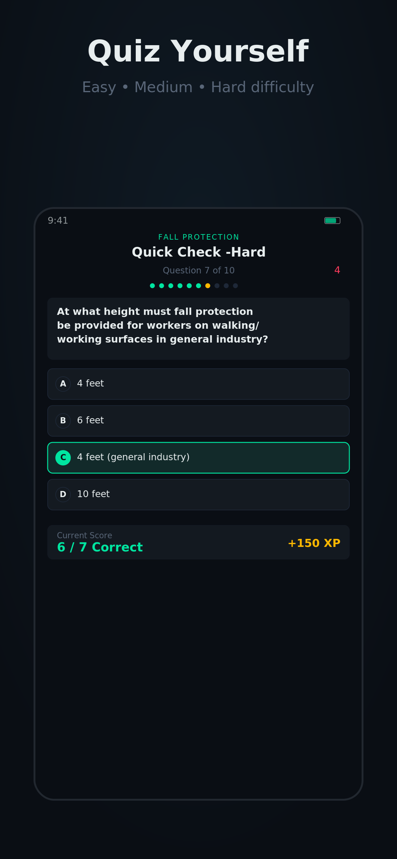
The App in Action
Home HQ
Modules
Progress
Quiz

Slide 5

Impact & Value
14
0
24/7
Training Modules
Data Collected
Access Anywhere
Covering core 1S0 competencies
Full privacy — nothing leaves the device
Train during downtime, TDY, or in the field
Standards-aligned (OSHA + AF guidance)
Built for 1S0s and Unit Safety Reps
Ready for App Store distribution

Slide 6

Ready to Elevate Safety Training
A free, privacy-first training tool built by an Airman for Airmen.
SSgt Abdoul Bah
abdoulbah1126@gmail.com

